Slide 1
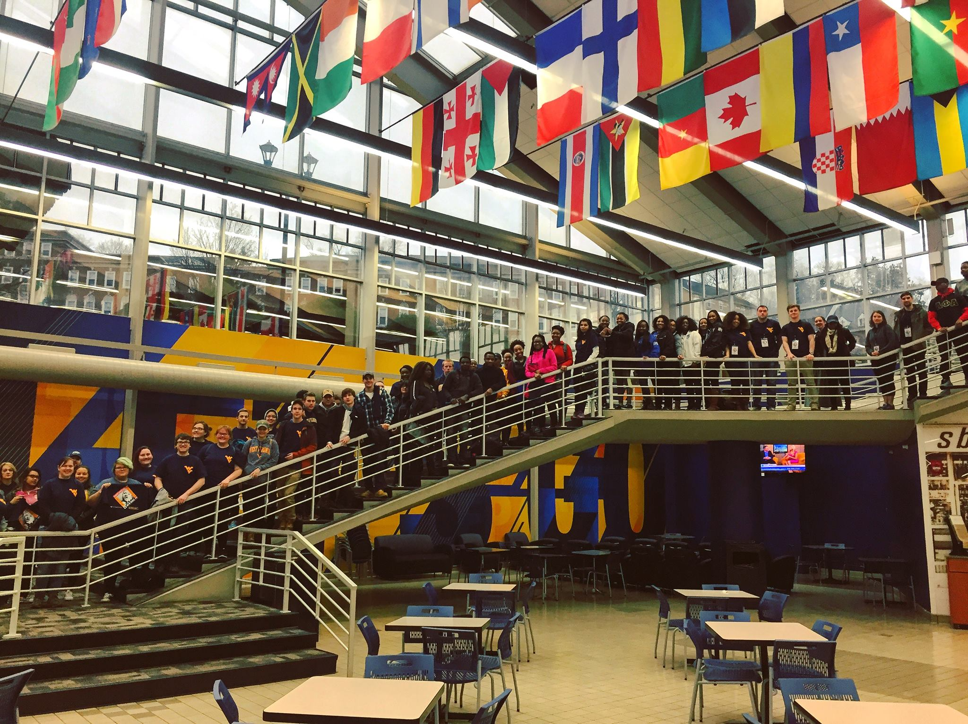
CSL Partner Training
Catherine Whitworth, MPA
Notes:
Welcome, Introductions

Slide 2
Agenda
Welcome and Introductions
What is Service?
Partner Benefits
Unleashing the Potential of iServe
Best Practices
Working with Service-Learning Students
Questions and Discussion
Notes:
1 minute
Where we are headed during our time here today

Slide 3
How does the CSL define Service?
  Community Service:
  The practice of volunteering one's time and talents to promote the common good and personal growth, while meeting actual community needs.
  Service-Learning:
  A teaching and learning strategy by which students learn through intentional and structured community service tied to specific learning outcomes and integrated through reflection.
Notes:
4 min
1. Review Partners only page and STRESS use by partners as best way to get PR on campus
2. How to become a Partner page for referrals or new staff

Slide 4
Community Service:
In-Kind Contributions/Fundraising:
Students may assist in fundraising activities
Monetary or in-kind contributions do not substitute for service
Organizations:
Non-profit
Governmental
Faith based doing community work
Community based grassroots
Attending fundraising events such as festivals, cook-offs are not typically considered direct service.
Campus organizations
  Approved service activities:
  Supervised, safe settings
  Meet the needs of community residents
  Promote learning and foster civic responsibility
  Unpaid
  Does not include service to private families or individuals
  Blood donation
  Refer to Volunteer Guidelines on iServe
Notes:
4 min
1. Review Partners only page and STRESS use by partners as best way to get PR on campus
2. How to become a Partner page for referrals or new staff

Slide 5
WVU BOG Policy 44 on Non-discrimination
West Virginia University is committed to fostering a diverse and inclusive culture by promoting diversity, inclusion, equality, and intercultural and intercommunity outreach. Accordingly, the University does not discriminate on the basis of race, color, national origin, ancestry, age, physical or mental disability, marital or family status, pregnancy, veteran status, service in the uniformed services (as defined in state and federal law), religion, creed, sex, sexual orientation, genetic information, gender identity, or gender expression in the administration of any of its educational programs, activities, or with respect to admission or employment.

Slide 6
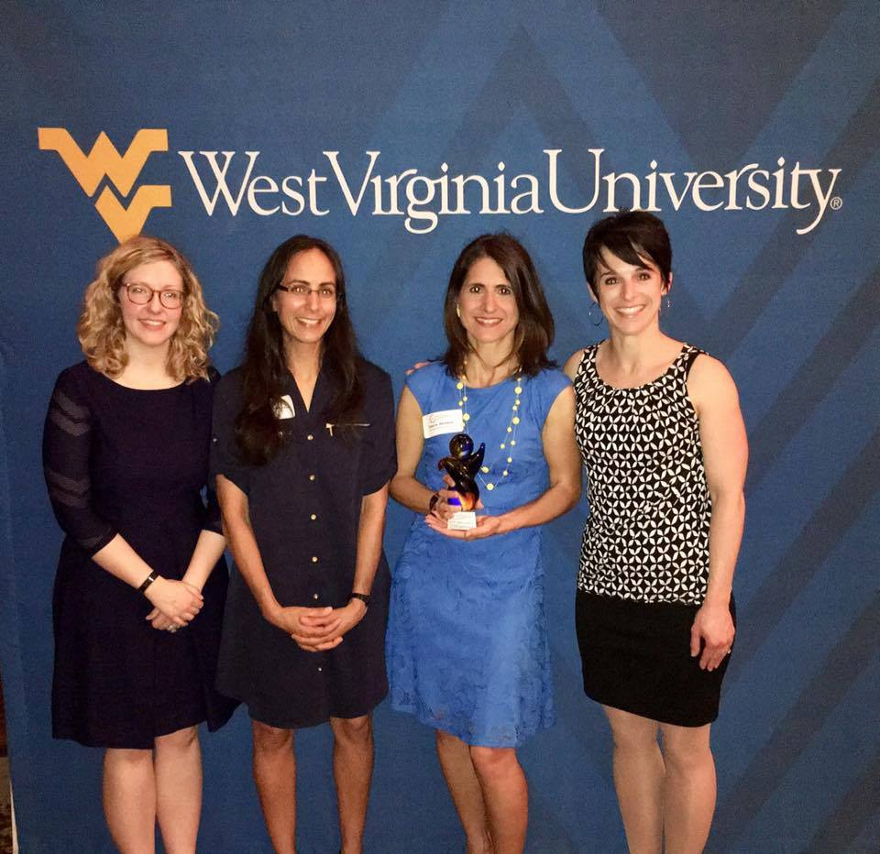
Partner Program
Partners Receive:
Organizational iServe Account
Consultation and connections to campus that support your mission and goals
Access to partner benefits through our Partner Resource page.
Partner Requirements:
Keep updated MOU on file with the CSL
Update contact information
Maintain process for recruiting, managing, and supervising volunteers including iServe
Opportunity for Service-Learning placements
First chance for special days of service & Night Serve
Promotion of your events and opportunities
Networking and Training events
Reciprocity as co-educators
Active engagement with WVU Students and the CSL
Students are Ensured:
  All sites are supervised and safe for students
  Service experiences provide learning opportunities and meet community needs
  Credit is given for their work
Notes:
4 min
1. Review Partners only page and STRESS use by partners as best way to get PR on campus
2. How to become a Partner page for referrals or new staff

Slide 7
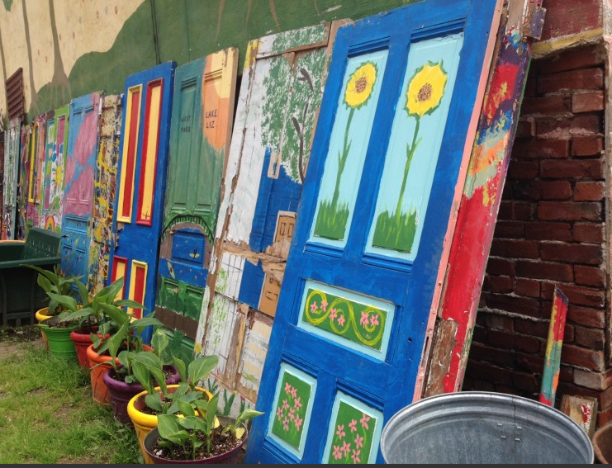
Partner Benefits
Portal:
Federal Work-Study Community Placements Access to Mountainlair Meeting Rooms
Other Resources:
The Foundation Center – Funding Information Network http://libguides.wvu.edu/grants
Printing of student produced materials
Mountaineer Trak – To post job announcements & internships
CSL Partners Facebook Group
Partners Resource Page:
http://service.wvu.edu/partners/partners-resource-page
Notes:
4 min
1. Review Partners only page and STRESS use by partners as best way to get PR on campus
2. How to become a Partner page for referrals or new staff

Slide 8
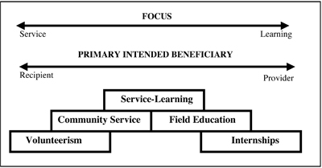
Service-Learning
A teaching and learning strategy by which students learn through intentional and structured community service tied to specific learning outcomes and integrated through reflection.
Varied Models
Small group projects
Individual hours
Collaboration with faculty and class

Slide 9
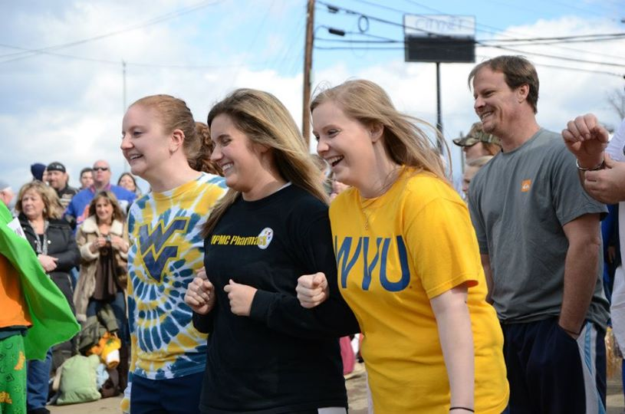
Service-Learning Group Project Process
CSL notifies partners of available courses for service-learning projects (July/Aug, Dec/Jan)
Partners post potential projects to iServe
Students view and sign up for service-learning projects at the start of semester
Student completes service & logs hours on iServe
Partner verifies service hours on iServe
Partner submits SL evaluation of student service to CSL (Nov/Dec, April/May)
Student and Partner complete SL contract and student returns contract to CSL. This may happened independently or at a partner meeting on campus
Partner may be invited to students’ final presentation
Notes:
4 min
Go over process briefly highlighting importance of dates and details on forms.

Slide 10
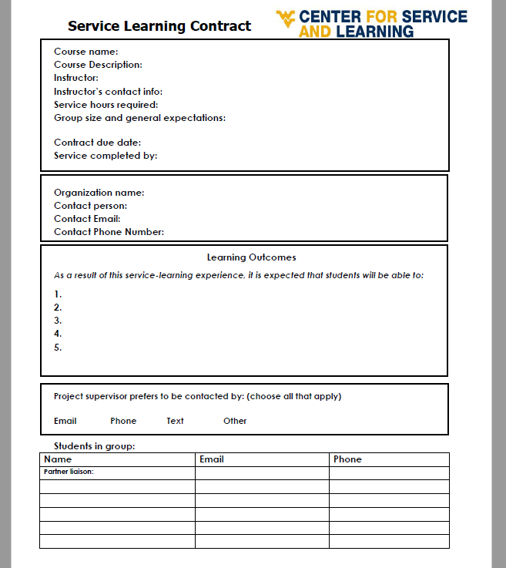
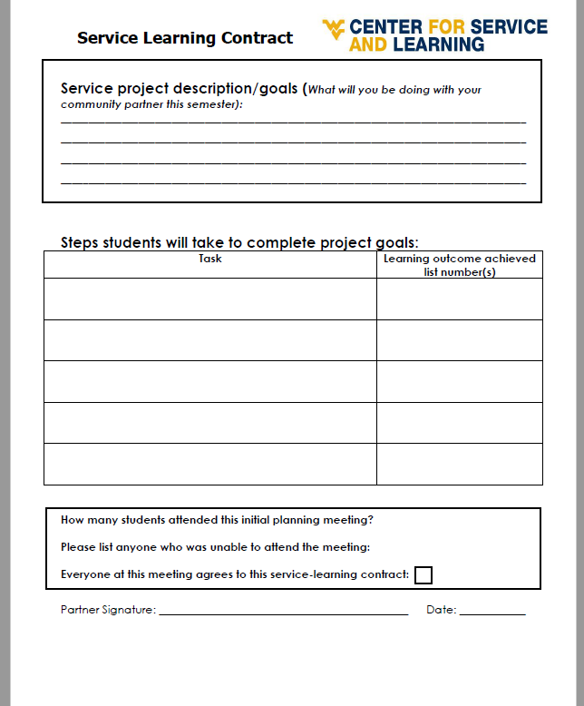
Service-Learning Contract
Notes:
4 min
Begin this about 55 minutes into presentation – you have 10 minutes left!

Slide 11
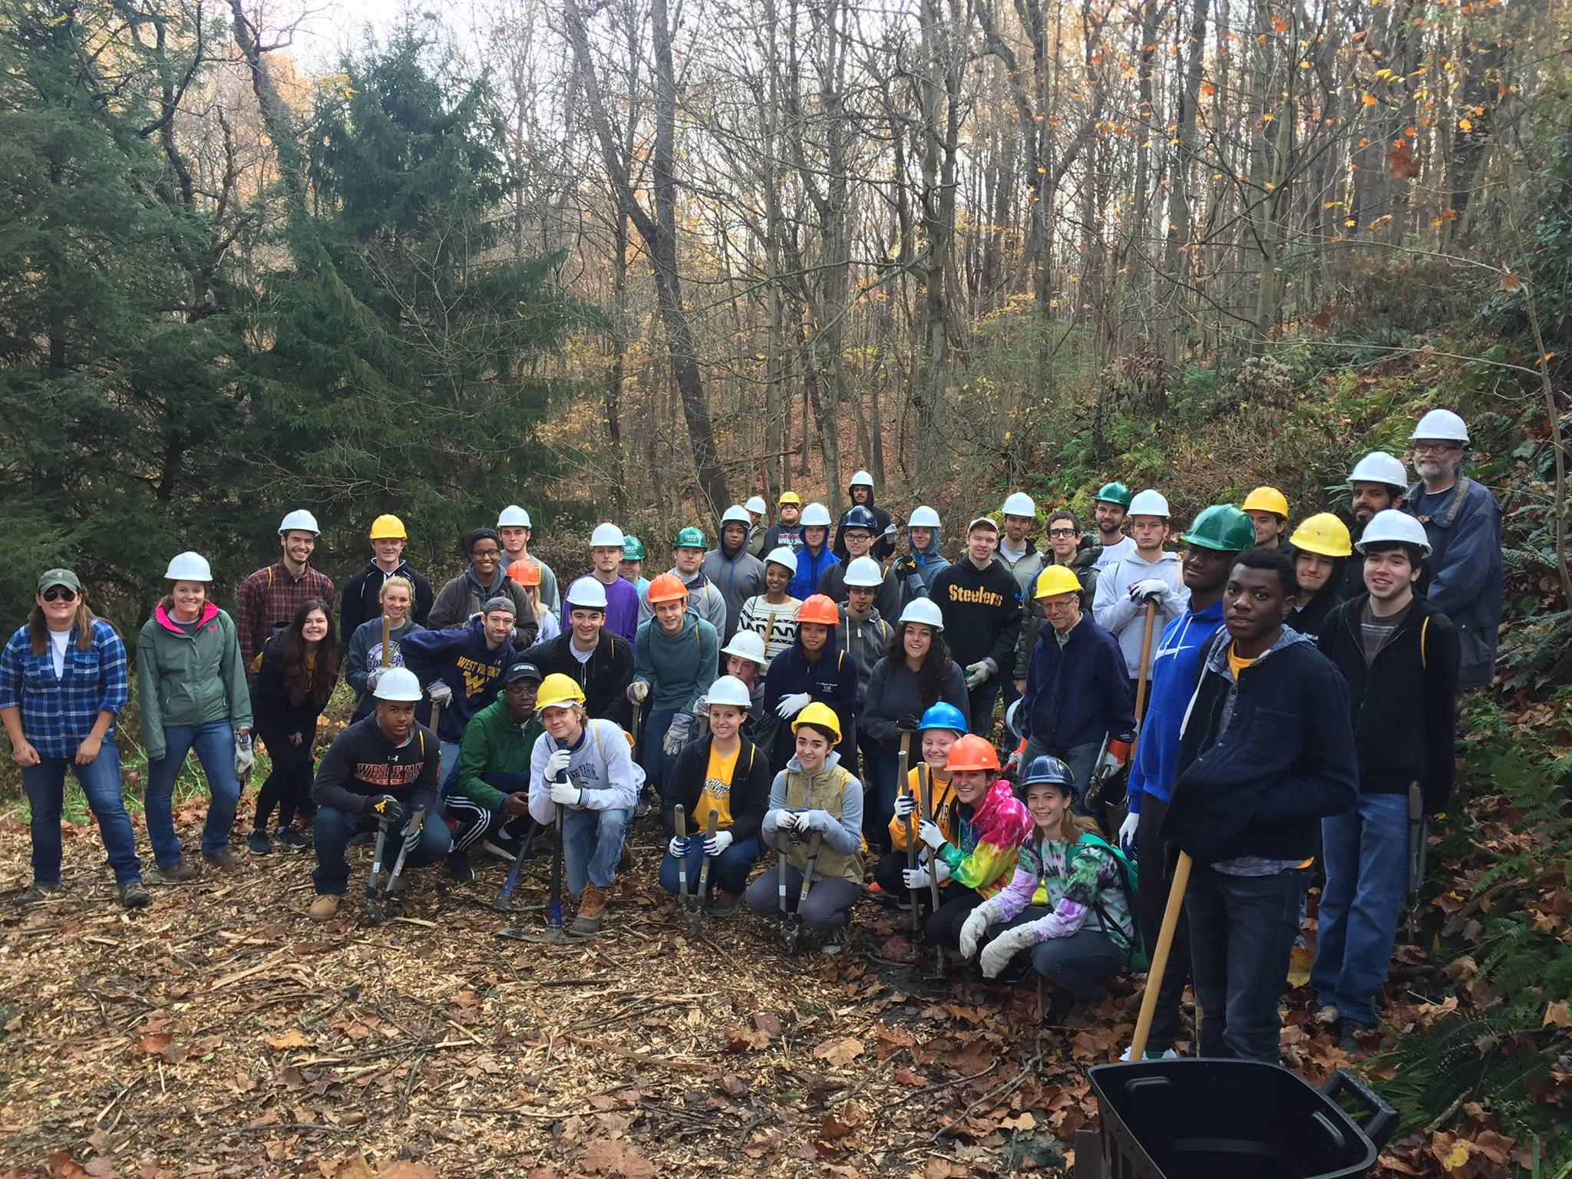
Catherine Whitworth
Partner Program Coordinator cwhitworth@mail.wvu.edu
304-293-8347
Lindsey Rinehart
Service-Learning Coordinator
Lindsey.Rinehart@mail.wvu.edu
304-293-8762
Andrew Facemire
iServe Administrator
Andrew.Facemire@mail.wvu.edu
304-293-8346

